Slide 1
Prescott Dispatch Center
2021 Annual Report

Slide 2
Participating Agencies
Bureau of Indian Affairs
Colorado River Agency
Fort Yuma Agency
Western Regional Office
Bureau of Land Management
Colorado River District
Phoenix District
Arizona State Office
United States Fish & Wildlife Service
Bill Williams National Wildlife Refuge
Cibola National Wildlife Refuge
Havasu National Wildlife Refuge
Imperial National Wildlife Refuge
Kofa National Wildlife Refuge
United States Forest Service
Prescott National Forest

Slide 3
2021 WildCAD Incidents
1,677 Total Incidents
All Incidents
Wildfires & Smoke Checks
Notes:
Wildfires and Smoke Check stats include all Wildfire incidents (stat, threat, agency assist, a/c, i/c, restriction enforcement, false alarms) and all smoke checks (relay to neighbor and Report only). FYA stats reported under BIA. PDC incidents = relay to neighbor and some agency assists that was a multi response.

Slide 4
WildCAD Incident Types
All Incident Types:
Wildfire
Prescribed Fire
Law Enforcement
Smoke Checks
Resource Orders
Vehicle Fires
Public Assist
Emergency Standby
SAR
Aircraft
Medical
Aircraft Down
Hazmat
Traffic Collision
Structure Fire
Miscellaneous
Wildfire Sub Types:
Statistical
Threat to Federal Land
Agency Assist
Abandoned Campfire
Illegal Campfire
Restriction Enforcements
False Alarm (response)
Smoke Checks Sub Types:
Report Only – No Action
Relay to Neighbor
Notes:
Wildfire Restriction Enforcement: abandoned campfires, illegal campfires, candles, grills, chainsaw, smoking -> during restrictions. Shooting during restrictions is classified as Law Enforcement Restriction Enforcement.

Slide 5
WildCAD Incident History
2021: 1,677 Incidents
April – Sept: 1,351 incidents - High.
Oct – Dec: 132 incidents - High.
Average 5 incidents per day - High.
Tuesdays and Thursdays saw the fewest incidents - Consistent.
Saturdays saw the most incidents (319) - Consistent.
50% of incidents occurred between 1000 & 1500 - Consistent.
2013: 1,040
2014: 1,124
2015: 1,074
2016: 1,226
2017: 1,893
2018: 1,828
2019: 1,768
2020: 2,426
2021: 1,677

Slide 6
Number of Incidents

Slide 7
WildCAD Incident History Cont.
2020
2021

Slide 8
834 Fire Related Incidents

Slide 9
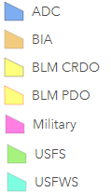
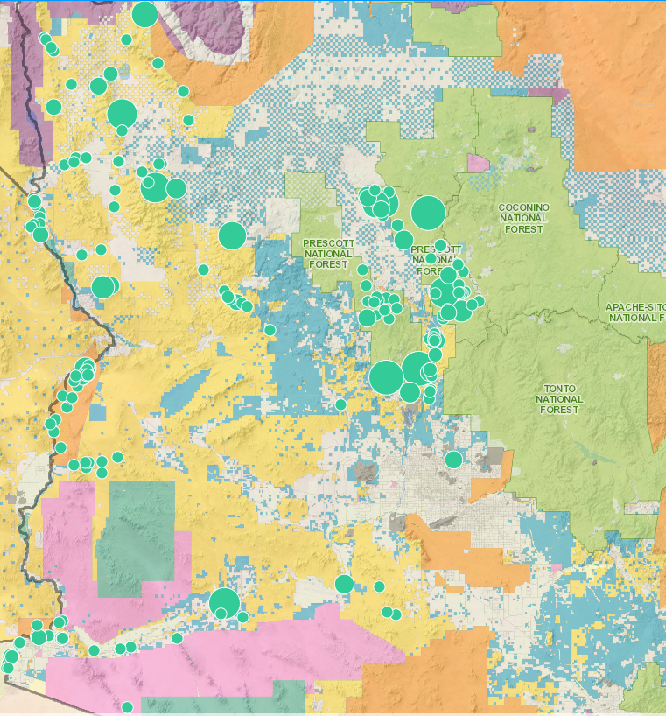
2020 Wildfires

Slide 10
2021 Statistical Wildfires (based on jurisdictional ownership)
90 Fires – 10,067 acres
49 Fires – 37,144 acres
49 Fires – 420 acres
5 Fires – 2446 acres
BLM
USFS
BIA
FWS

Slide 11
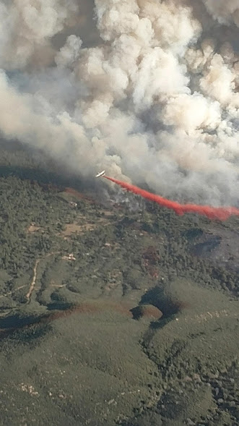
IMT Incidents
Tussock (AZ-PHD)
Type 1 - IC: Dave Bales
Started on May 8th
Total of 5,546 acres
Declared Out on June 13th4
Flag (AZ-CRD)
Type 1 - IC: Alan Sinclair
Started on April 25th
Total of 1,267 acres
Declared Out on June 6th17
Rafael (AZ-PNF)
Type 1 – IC: Dave Bales
Started on June 18th
Total of 78,065 acres
Declared Out on September 12th
Tiger (AZ-PNF)
Type 2 – IC: Dave Gesser
Started on June 30th
Total of 16,278 acres
Declared Out on September 12th
Rock Butte (5 fires) (AZ-PNF)
Type 3 – IC: Ryan Barela
Started on June 17th
Total of 802 acres
Declared Out on July 13th

Slide 12
2021 Restrictions/Closures
Prescott National Forest
Stage 1: May – June.
Forest Closure: June – July.
Stage 1: July
Shooting restrictions were also included in Stage 1.
Bureau of Indian Affairs / Tribal Partners
Stage 1: January – May. Closure: May – January 2022.
Bureau of Land Management (CRD/PHD)
Stage 1: May – June
Stage 2: June - July
Fish and Wildlife
Standard restrictions in effect year-round.

Slide 13
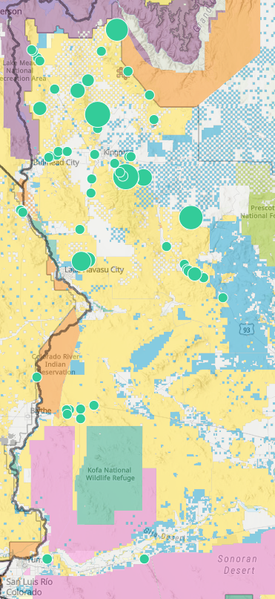
CRD Fire Activity - 2021
Fire Size Class
A: 0 - .25
B: .26 - 9.9
C: 10 - 99
D: 100 - 299
E: 300 - 999
F: 1000 - 4999
G: 5000 +
Flag (4/25) 1,267 acres
82 Statistical Fires
4,499 Acres
17 CRD Lightning Caused
2,962 Acres
44 CRD Human Caused
1,325 Acres
Fire Size Class C+:
3 Fires – 1,294 Acres
Fire Size Class A/B:
42 Fires - 31 Acres
Fire Size Class C+:
7 Fires – 2,958 Acres
Fire Size Class A/B:
10 Fire - 4 Acres
- CRD (61 – 4,287 acres) - Park (0)
- BOR agreement (11 - 13 acres) - MSCP (0)
- FYA agreement (10 - 199 acres)
False Alarm Response: 45
Agency Assist: 9
Threat Fires: 4 – 2,130 ac
2018: 45 Fires – 982 acres
2019: 48 Fires – 1,419 acres
2020: 71 Fires – 4,336 acres

Slide 14
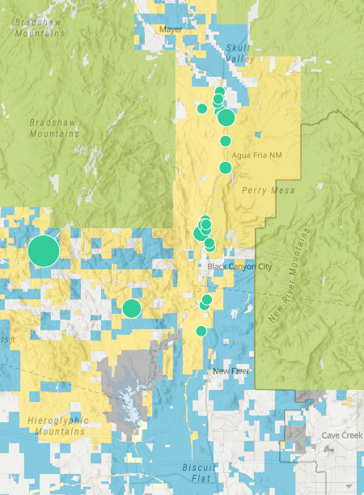
PHD Fire Activity - 2021
Tussock (05/08) 5,545
Fire Size Class
A: 0 - .25
B: .26 - 9.9
C: 10 - 99
D: 100 - 299
E: 300 - 999
F: 1000 - 4999
G: 5000 +
29 Statistical Fires
5,779 Acres
1 Lightning Caused
99 Acres
28 Human Caused
5,680 Acres
Fire Size Class C+:
3 Fires – 5,656 Acres
Fire Size Class A/B:
25 Fires - 23 Acres
Fire Size Class C+:
1 Fire - 99 Acres
Fire Size Class A/B:
0 Fires – 0 Acres
- PHD (29 – 5,779 acres)
- BOR agreement (0 – 0 acres)
False Alarm Response: 21
Agency Assist: 6
Threat Fires: 2 - 44 acres
2018: 33 fires – 74 acres
2019: 46 fires – 3,458 acres
2020: 75 fires – 12,949 acres

Slide 15
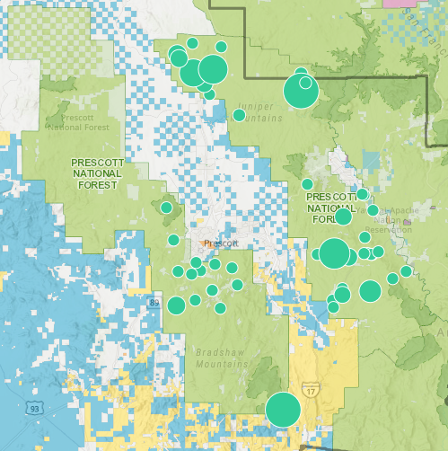
PNF Fire Activity - 2021
Rafael (6/18) 78,065 acres (23,168 on PNF)
Tiger (6/30) 16,278 acres (11,670 on PNF)
Fire Size Class
A: 0 - .25
B: .26 - 9.9
C: 10 - 99
D: 100 - 299
E: 300 - 999
F: 1000 - 4999
G: 5000 +
49 Statistical Fires
96,649 Acres
27 Lightning Caused
95,346 Acres
22 Human Caused
1,303 Acres
Fire Size Class C+:
4 Fires – 1,287 Acres
Fire Size Class A/B:
18 Fires - 2 Acres
Fire Size Class C+:
9 Fire – 95,336 Acres
Fire Size Class A/B:
18 Fires - 10 Acres
False Alarm Response: 38
Agency Assist: 13
Threat Fires: 6
2018: 61 fires – 8,875 ac
2019: 45 fires – 31,775 ac
2020: 52 fires – 12,182 ac

Slide 16
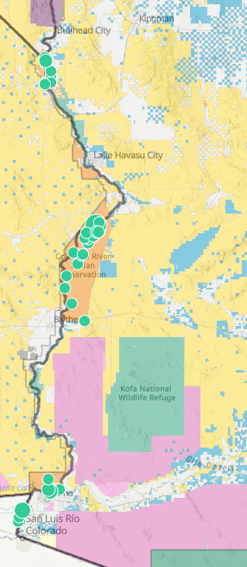
Fire Size Class
A: 0 - .25
B: .26 - 9.9
C: 10 - 99
D: 100 - 299
E: 300 - 999
F: 1000 - 4999
G: 5000 +
BIA Fire Activity - 2021
50 Statistical Fires
421 Acres
1 Lightning Caused
0.25 Acres
49 Human Caused
420 Acres
Fire Size Class C+
2 Fires - 86 Acres
Fire Size Class A/B:
47 Fires - 334 Acres
Fire Size Class C+
0 Fires – 0 Acres
Fire Size Class A/B:
1 Fire – 0.25 Acres
- CRA (40 – 222 acres)
- FYA (10 - 199 acres)
False Alarm Response: 10
Agency Assists: 1
Threat Fires: 1 - 0.15 acres
2018: 33 fires – 673 acres
2019: 30 fires – 80 acres
2020: 57 fires – 304 acres

Slide 17
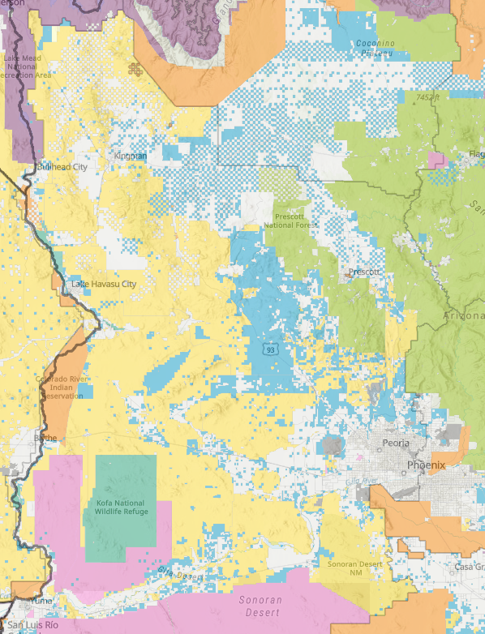
Fire Size Class
A: 0 - .25
B: .26 - 9.9
C: 10 - 99
D: 100 - 299
E: 300 - 999
F: 1000 - 4999
G: 5000 +
FWS Fire Activity - 2021
5 Statistical Fires
2,446 Acres
4 Lightning Caused
2,446 Acres
1 Human Caused
0.1 Acre
Fire Size Class C+
0 Fires - 0 Acres
Fire Size Class A/B:
1 Fires – 0.1 Acre
Fire Size Class C+
4 Fires – 2,446 Acres
Fire Size Class A/B:
0 Fires - 0 Acres
-
- CBR (0 – 0) - BWR (1 – 1,260 ac)
- HVR (2 – 80 ac) - KGR (0)
- IMR (2 – 1,106 ac)
False Alarm Response: 1
Agency Assists: 0
Threat Fires: 0
2018: 1 fire – 0 acres
2019: 5 fires – 28 acres
2020: 11 fires – 117 acres

Slide 18
Prescribed Fire Activity
Agency | Burn Name | Burn Days | Acres Accomplished
CRD | Mittry Lake Piles | 1 | 5
CRD | Parker Strip Piles | 1 | 1
CRD | Pine Lake Piles | 8 | 31
CRD | Vinagre Wash Piles | 1 | 20
CRD | La Posa LTVA Piles | 1 | 1
HVR | Lost Lake | 1 | 700
IMR | Imperial Research Fields | 1 | 11
CBR | Hart Mine Marsh | 1 | 250
BWR | Bill Williams Piles | 1 | 5
CRA | Dam Piles | 1 | 5
PNF | Pipeline | 2 | 700
PNF | East Zone Piles | 3 | 155
PNF | West Zone Piles | 40 | 1,390
PNF | White Spar | 1 | 415
PNF | Lower Wolf Creek | 3 | 1,600

Slide 19
2021 Resource Ordering/Mobilization
Overhead
Processed 3,751 requests
PDC Resources include BIA, BLM, FWS & USFS overhead
Supplies
Processed 3,165 requests
Requests include ongoing fire and incident replacement (NFES and non-NFES supplies)
Equipment
Processed 1,060 requests
PDC Resources include BIA, BLM, FWS, USFS and contract vendor equipment
Aircraft
Processed 530 requests
PDC Resources include USFS & BLM helicopters
Crews
Processed 129 requests
PDC Resources include USFS IHC & Fire Suppression Module

Slide 20
NFDRS
Operate the Weather Information Management System (WIMS) for 15 DOI RAWS and 4 USFS RAWS
Document and disseminate NFDRS Indices and Components to field units
Produce and distribute Fire Danger/Outlook/Current Conditions document for DOI & USFS units
Maintain 4 USFS fixed-site RAWS and 1 USFS portable RAWS according to NWCG standards
Produce Prescott NF Fire Danger Pocket Cards according to NWCG standards
Calculate the Local Preparedness Level for Prescott NF and communicate to field units
Implement the Western Arizona Zone NFDRS Operating Plan
Utilize FireFamilyPlus software to provide fire management with tools to aid in decision making

Slide 21
Mapping
Manage PDC ArcGIS Online project with shared access to multiple layers
Create new layers to meet agency/PDC needs
Coordinate with agency’s GIS specialists for updates
Provide on-demand map products
Edit Response Areas as needed

Slide 22
AD Program
2020
Employees 33
Training Assignments 38
2019
Employees 22
Fire Assignments 89
Training Assignments 24
Fire Assignments 146
2018
Training Assignments 26
Employees 32
Fire Assignments 101
2021
Employees 30
Fire Assignments 175
Training Assignments 10

Slide 23
PDC Website
Manage site to provide products & services in support of the participating agencies and PDC staff

Slide 24
2021 PDC Staffing
Center Manager: Barry Wallace
Assistant Center Manager: Bec Sandle
Assistant Center Manager: Alanna English
IA/Aircraft Dispatcher: Ashley Epright
IA/Aircraft Dispatcher: Brandon Padron
IA/Aircraft Dispatcher: Vacant
Intelligence/Support: Viola Plummer
Logistics Dispatcher: Sonja Hess

Slide 25
2021 Accomplishments
Successful transition to FireNet, IROC, InFORM and cloud based WildCAD.
Staffed Expanded Dispatch from May to June.
Staffed with a night shift from May to July.
Increased capabilities with virtual dispatching and teleworking.
Developed and trained Dispatch Militia workforce of 10 dispatchers.
PDC Staff received training and assignment opportunities.
Maintained/monitored network of weather stations with no down-time or loss of data.
Successfully managed Prescott NF AD Program, timely processing of travel and time
Provided personnel for training courses, hiring events and local emergency drills.
Enhanced & maintained PDC Website.
Provided IQCS program management assistance.
Maintained WildCAD database including phone directory, run cards, resources.
Remained on the cutting edge of Dispatch information technology.

Slide 26
Looking into 2022…
NFDRS
Enhance and implement interagency Fire Danger Operating Plan for the PDC area of responsibility (PNF, BLM, BIA, FWS)
Transition NFDRS2016 with revised SIGs, new fuel models, updated Pocket Cards
IROC
Continued development and enhancement, and training
IRWIN
Track the latest system integration
InFORM
The mobile application Collector replaced by Field Maps.
AGOL
Enhance ArcGIS Online for incident mapping and intel.
Used for Initial Attack and Aircraft dispatching
CAD
Prepare for next generation of CAD (WildCAD-E) coming in spring of 2023
FireNet
Transition PDC files and folders from NAS to FireNet
Establish PDC SharePoint site with easy access to files

